Slide 1
Python – Statistical Data Analysis

Slide 2

30 Days Data Scinece & Analytics Master Class
Day1 : Python for Data Science
Time: 6.00 PM IST
Free Registration

Slide 3
30 Days Data Scinece & Analytics Master Class
Handbook

Slide 4
NANDHINI.S
Exp: 5 Yrs
Expert in
Python Developer on Machine Learning
Deep learning with computer vision
Matlab – Image Processing
Autonomous Car design using ROS with LIDAR
Language – Python , Java , HTML ,CSS.
Tools – ANACONDA NAVIGATOR, JUPYTER NOTEBOOK,
GOOGLE COLAB.
Graduation : BE – ECE | 2011

Slide 5
Pantech?
Educational Equipment Manufacturer
IoT, AI, Robotics,Autonomous Robot
Microprocessor/Microcontroller
DSP,VLSI, Embedded System
Power Electronics & Drives, Fuel Cell Trainer Kit
Renewable Energy Lab, Electric Vehicle Lab
Technical Training
DIY Project

Slide 6

What is Master Class ?
👍 This is the 30 Days Industrial Learning Activity.
👍 Its Online YouTube Live Class
👍 If you Invest 45 minutes daily, U will become Master in Data Science
👍 You will get FREE E-Certificate
Webinar Participation Certificate
“Learning is the beginning of wealth.
Searching & Learning is where the miracle process all begins.” …………….Jim Rohn

Slide 7
Our Vision
Help 10 Million Students to Learn the Technology in Easy Way

Slide 8

Associate Partner for this Master Class
https://apssdc.in/home/

Slide 9
What U will Learn from 30 Days Data Science & Analytics Master Class

Slide 10





Data Science & Analytics Learning Plan
01
02
03
04
05
Library
Python
Analytics
Tools
Industry Project
Introduction To Python and Python Data Structures
Pandas
Numpy
MatplotLib
Cborn, SKLearn Lib
Collab
Distribution
Visualization
Aggregation
Statistics
PowerBi
Tableo
Project Building,
DSA Jobs

Slide 11
Day wise Learning Plan
Day -1 : Python for Data Science (5 Solved end-to-end Data Science Projects in Python)
Day -2: Advanced Python Programming
Day -3: Pandas Library – Introduction
Day -4: Pandas Library – Data Structures
Day -5: Numpy library – Array Operations | Mathematical Functions
Day -6: Numpy – Sort, Search and Counting Functions
Day -7: Matplotlib , Histogram Using Matplotlib | I/O With Numpy
Day -8: Matplotlib Library – Introduction , Pyplot API | Types Of Plots
Day -9: Seaborn Library
Day -10: SKLearn Library
Day -11: Google Colab Notebook
Day -12: Python – Date and Time, Data Wrangling
Day -13: Python – Data Aggregation
Day -14: Python – Word Tokenization , Stemming and Lammetization
Day -15: Python – Data Visualization

Slide 12
Day wise Learning Plan
Day -16: Python – Statistical Analysis
Day -17: Python – Types Of Distribution
Day -18: Python – Correlation ,Chi-Square Test , Linear Regression
Day -19: Tableau – Introduction and Tools
Day -20: Tableau – Data Sources , Worksheets
Day -21: Spatial Data Science For Covid-19 Disease Prediction
Day -22: Power-BI – Introduction, Installation Steps and Architecture
Day -23: Power-BI – Data Modelling , Visualization Options | Excel Integration
Day -24: Parkinson’s Disease Prediction – XG Boost Classifier
Day -25: House Price Prediction using Random Forest Regression
Day -26: Customer Segmentation Using ML – K-Means Clustering
Day -27: Home Loan Prediction using Decision Tree Classifier
Day -28: Spam Classification using NLP
Day -29: Hand Written Digit Recognition Using CNN
Day -30: Churn Prediction using Deep Learning

Slide 13
List of Projects for Demo in YouTube Live
Spatial Data Science For Covid-19 Disease Prediction
Parkinson’s Disease Prediction-XGBoost Classifier
House Price Prediction-Random Forest Regression
Customer Segmentation Using ML-K-Means Clustering
Home Loan Prediction-Decision Tree Classifier
Spam Classification-NLP
Hand Written Digit Recognition Using Python-CNN
Churn Prediction-Deep Learning
Crop Yield Prediction
Ground water level prediction
All Projects in Jupyter Notebook

Slide 14
What you will get from this Free 30 Days Master Class?
You can attend YouTube Live Class
Free E-Certificate ( WEBINAR PARTICIPATION CERTIFICATE)

Slide 15
How to mark your Attendance in YouTube Live Class?
Ans : During the Live Class, organizer will post Google Form link in Live Chat. The Participants should submit the from on daily basis. Minimum 25 Days Attendance is Required to get Free Master Class Participation Certificate.
Note : The Link will be available during the Live. From the LIVE Class date, the live video will get removed from the YouTube in 3 days.

Slide 16


Sample Webinar Participation Certificate?

Slide 17
https://www.pantechelearning.com/data-science-master-class/
On Demand
You can get chance to apply 1 Month Internship on Data Science & Analytics Master Class

Slide 18
What is Internship????
Learn
Practice
Verify
Get Certified
Grow

Slide 19
Free Master Class DSA | 1 Month Internship on DSA
Master Class Participation Certificate | Internship Completion Certificate
Minimum 25 Class should attend YouTube Live | Recorded Class Link will be provided. – LMS Portal Access
YouTube Live Mandatory | Your Choice. You can attend Live or else You can watch Recorded Class in LMS Portal
All Projects Demo class in YouTube Live | Step by Step Video Explanation Content in LMS Portal
Access : 3 Days | VIP WhatsApp Group Support
 | You Can Download All PPTs
 | 4 Nos of Hackathon Class in Zoom Live. The Recording also will be provided
 | You Can Download All Project Files
 | Mentor will guide you to finish 10 Projects
 | Access : 60 Days

Slide 20
Pantech will make you to Create 10 Projects in Data Science & Analytics in 30 Days
Objective of this 30 Days Master Class

Slide 21
1 Month Internship in Data Science
INTERNSHIP E-Certificate(30Days Internship on Data Science Engineering)
Highly organized Video content
Download All Files
Download PPTs
Assignments
Flexible Time.
Access Period: 60Days from the date of payment

Slide 22
What You Will Get???
Complete Project Files
30 Days Learning Activity
Data Science Core Concepts
10 + Projects
Project PPT
Spatial Data Science For Covid-19 Disease Prediction
Parkinson’s Disease Prediction-XGBoost Classifier
House Price Prediction-Random Forest Regression
Customer Segmentation Using ML-K-Means Clustering
Home Loan Prediction-Decision Tree Classifier
Spam Classification-NLP
Hand Written Digit Recognition Using Python-CNN
Churn Prediction-Deep Learning
Crop Yield Prediction
Ground water level prediction
Video Class Access for 2 Months
Get chance to Enroll 1-Month Internship on demand

Slide 23

How to join in 1 month Internship
https://www.pantechelearning.com/data-science-master-class/
Click Here
Coupon Code: DSABATCH3

Slide 24


Slide 25
Python – Measuring Central Tendency
Central tendency means measuring the center or distribution of location of values of a dataset.
It gives an idea of the average value of data in the dataset and also an indication of how widely the values are distributed in the dataset.
It helps in evaluating the chances of a new input fitting into the existing dataset hence probability of success.

Slide 26
Python – Measuring Central Tendency
There are three main measures of central tendency which can be calculated using methods in pandas python library.
Mean – It is the average value of the data which is the division of the sum of the values with the number of values.
Median- It is the middle value in the distribution when the values are arranged in the ascending or descending order.
Mode – It is the most commonly occuring value in the distribution.

Slide 27
Python – Calculating Mean and Median
import pandas as pd
#Create a Dictionary of series
d = {'Name':pd.Series(['Tom','James','Ricky','Vin','Steve','Smith','Jack', 'Lee','Chanchal','Gasper','Naviya','Andres']), 'Age':pd.Series([25,26,25,23,30,29,23,34,40,30,51,46]), 'Rating':pd.Series([4.23,3.24,3.98,2.56,3.20,4.6,3.8,3.78,2.98,4.80,4.10,3.65])}

Slide 28
Python – Calculating Mean and Median
#Create a DataFrame
df = pd.DataFrame(d)
print ("Mean Values in the Distributio”)
print (df.mean())
print ("*******************************“)
print ("Median Values in the Distribution“)
print (df.median())

Slide 29
Calculating Mean and Median - Output
Mean Values in the Distribution
Age 31.833333
Rating 3.743333
dtype: float64
*******************************
Median Values in the Distribution
Age 29.50
Rating 3.79
dtype: float64

Slide 30
Python – Calculating Mode
Mode may or may not be available in a distribution depending on whether the data is continuous or there are values whiach has max. frequency.
A simple distribution is taken to find out the mode.
There is a value which has max.frequency in the distribution.

Slide 31
Python – Calculating Mode
import pandas as pd
#Create a Dictionary of series
d = {'Name':pd.Series(['Tom','James','Ricky','Vin','Steve','Smith','Jack', 'Lee','Chanchal','Gasper','Naviya','Andres']), 'Age':pd.Series([25,26,25,23,30,25,23,34,40,30,25,46])}
#Create a DataFrame
df = pd.DataFrame(d)
print (df.mode())

Slide 32
Python – Calculating Mode - Output
Age Name
0 25.0 Andres
1 NaN Chanchal
2 NaN Gasper
3 NaN Jack
4 NaN James
5 NaN Lee

Slide 33
Python – Calculating Mode - Output
6 NaN Naviya
7 NaN Ricky
8 NaN Smith
9 NaN Steve
10 NaN Tom
11 NaN Vin

Slide 34
Python – Measuring Variance
Variance is a measure of how far the value in a datset lies from the mean value.
It is a measure of how dispersed the values are.
It is measured by using standard deviation.
The other method commonly used is skewness.

Slide 35
Python – Measuring Std Deviation
It is a square root of variance.
Variance is the average of the average of the squared difference of values in a data set from the mean value.
import pandas as pd
#Create a Dictionary of series
d = {'Name':pd.Series(['Tom','James','Ricky','Vin','Steve','Smith','Jack', 'Lee','Chanchal','Gasper','Naviya','Andres']), 'Age':pd.Series([25,26,25,23,30,25,23,34,40,30,25,46]), 'Rating':pd.Series([4.23,3.24,3.98,2.56,3.20,4.6,3.8,3.78,2.98,4.80,4.10,3.65])}

Slide 36
Python – Measuring Std Deviation
#Create a DataFrame
df = pd.DataFrame(d)
# Calculate the standard deviation
print df.std()

Slide 37
Python – Std Deviation - Output
Age 7.265527
Rating 0.661628
dtype: float64

Slide 38
Python – Measuring Skewness
It is used to determine if the data is symmetric or skewed.
If the index is between -1 and +1 , then the distribution is symmetric.
If the index is no more than -1 , then it is skewed to the left and if it is at leaat +1 , then it is skewed to the right.

Slide 39
Python – Measuring Skewness
It is used to determine if the data is symmetric or skewed.
If the distribution is between -1 and +1, then the distribution is symmetric.
If the index is no more than -1 , then it is skewed to the left and if it is atleast 1, then it is skewed to the right.

Slide 40
Python – Measuring Skewness
import pandas as pd
#Create a Dictionary of series
d = {'Name':pd.Series(['Tom','James','Ricky','Vin','Steve','Smith','Jack', 'Lee','Chanchal','Gasper','Naviya','Andres']), 'Age':pd.Series([25,26,25,23,30,25,23,34,40,30,25,46]), 'Rating':pd.Series([4.23,3.24,3.98,2.56,3.20,4.6,3.8,3.78,2.98,4.80,4.10,3.65])}
#Create a DataFrame
df = pd.DataFrame(d)
print(df.skew())

Slide 41
Python - Output
Age 1.443490
Rating -0.153629
dtype: float64

Slide 42
Python – Normal Distribution
The normal distribution is a form of presenting data by arranging the probability distribution of each value in the data.
Most values remain around the mean value making the arrangement symmetric.
Various functions in the numpy library are used to mathematically calculate the values for a normal distribution.
Histograms are created over which we plot the probability distribution curve.

Slide 43
Python – Normal Distribution
import matplotlib.pyplot as plt
import numpy as np
mu, sigma = 0.5, 0.1
s = np.random.normal(mu, sigma, 1000)
# Create the bins and histogram
count, bins, ignored = plt.hist(s, 20, normed=True)
# Plot the distribution curve
plt.plot(bins, 1/(sigma * np.sqrt(2 * np.pi)) *
np.exp( - (bins - mu)**2 / (2 * sigma**2) ), linewidth=3, color='y')
plt.show()

Slide 44
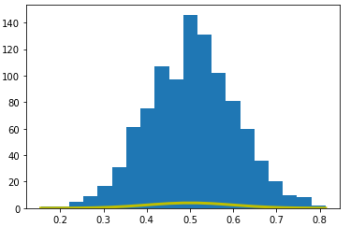
Normal Distribution - Output

Slide 45
Python – Binomial Distribution
The Binomial distribution model deals with the probability of success of an event whiach has only two possible outcomes in a series of experiments.
For ex , tossing a coin always gives a head or a tail.
The probability of finding exactly 3 heads in tossing a coin repeatedly for 10 times is estimated during the binomial distribution.

Slide 46
Python – Binomial Distribution
Seaborn library has in-built functions to create probability distribution graphs.
Scipy package helps in creating the binomial distribution.

Slide 47
Python – Binomial Distribution
from scipy.stats
import binom import seaborn as sb
binom.rvs(size=10,n=20,p=0.8)
data_binom = binom.rvs(n=20,p=0.8,loc=0,size=1000)
ax = sb.distplot(data_binom, kde=True, color='blue', hist_kws={"linewidth": 25,'alpha':1})
ax.set(xlabel='Binomial', ylabel='Frequency')

Slide 48
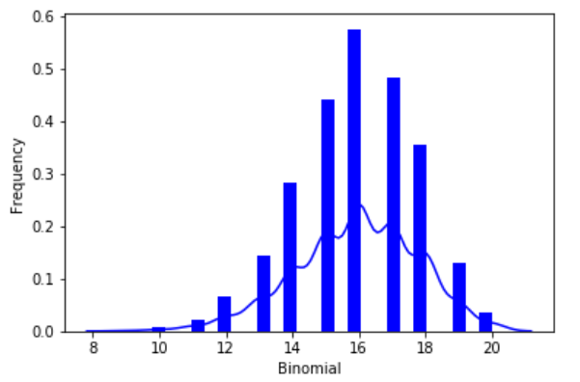
Binomial Distribution - Output

Slide 49
Python – Poisson Distribution
It is a distribution which shows the likely number of times that an event will occur within a pre – determined period of time.
It is used for independent events which occur at a constant rate within a given interval of time.
The poisson distribution is a discrete function , meaning that the event can only be measured as occuring or not occuring , meaning that the variable can only be measured in whole numbers.
Seaborn library has some in-built functions to create such probability distribution graphs.

Slide 50
Python – Poisson Distribution
from scipy.stats import poisson
import seaborn as sb
data_binom = poisson.rvs(mu=4, size=10000)
ax = sb.distplot(data_binom,
kde=True,
color='green',
hist_kws={"linewidth": 25,'alpha':1})
ax.set(xlabel='Poisson', ylabel='Frequency')

Slide 51
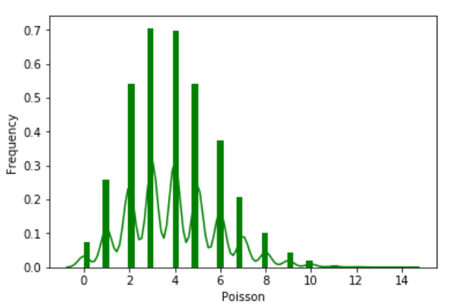
Poisson Distribution - Output

Slide 52
Python – Bernoulli Distribution
Bernoulli distribution is a special case of binomial distribution.
A single experiment is conducted where the number of observation is one.
Bernoulli distribution therefore describes events exactly having two outcomes.
Various functions in numpy library are used to mathematically calculate the values of Bernoulli distribution.

Slide 53
Python – Bernoulli Distribution
from scipy.stats import bernoulli
import seaborn as sb
data_bern = bernoulli.rvs(size=1000,p=0.6)
ax = sb.distplot(data_bern, kde=True, color='crimson', hist_kws={"linewidth": 25,'alpha':1})
ax.set(xlabel='Bernouli', ylabel='Frequency')

Slide 54
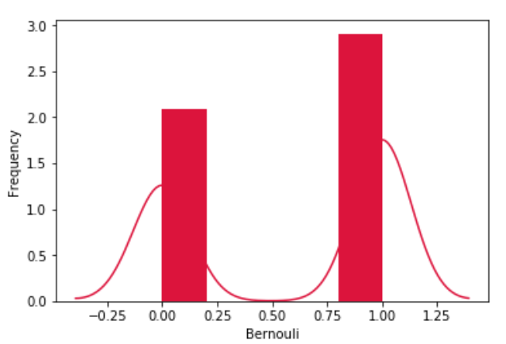
Bernoulli Distribution - Output

Slide 55
Python – P - Value
The p-value is about the strength of a hypothesis.
Hypothesis is being built based on some statistical model and compare the model’s validity using p-value.
One way to get the p-value is by using the T-test.
This is a two-sided test for the null hypothesis that the expected value(mean) of a sample of independent observations ‘a’ is equal to the given population mean , popmean.

Slide 56
Python – P - Value
from scipy import stats
rvs = stats.norm.rvs(loc = 5, scale = 10, size = (50,2))
print (stats.ttest_1samp(rvs,5.0))

Slide 57
P – Value - Output
Ttest_indResult(statistic = -0.67406312233650278, pvalue = 0.50042727502272966)

Slide 58
Python - Correlation
It refers to some statistical relationships involving dependence between two data sets.
Examples of dependent phenomena include correlation between the price of the product and the supplied quantity.
Take the iris dataset.
Try to establish the relationship between length and width of sepals and petals of three species of iris flower.

Slide 59
Correlation - Example
import matplotlib.pyplot as plt
import seaborn as sns
df = sns.load_dataset('iris')
#without regression
sns.pairplot(df, kind="scatter")
plt.show()

Slide 60
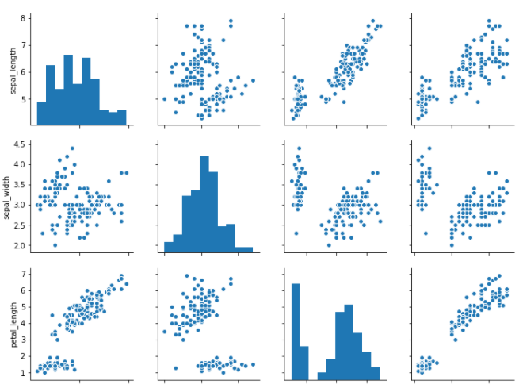
Correlation - Output

Slide 61
Python – Chi – Square - Test
It is a statistical method to find if two categorical variables have significant correlation between them.
Both these variables should be from same population and they should be categorical like Yes/No , Male/Female , Red/Green.etc.
For eg , we can build a data set with observations on people’s ice – cream buying pattern and try to correlate the gender of a person with the flavour of ice – cream they prefer.

Slide 62
Python – Chi – Square - Test
from scipy import stats
import numpy as np
import matplotlib.pyplot as plt
x = np.linspace(0, 10, 100)
fig,ax = plt.subplots(1,1)
linestyles = [':', '--', '-.', '-']
deg_of_freedom = [1, 4, 7, 6]
for df, ls in zip(deg_of_freedom, linestyles):
ax.plot(x, stats.chi2.pdf(x, df), linestyle=ls)

Slide 63
Python – Chi – Square - Test
plt.xlim(0, 10)
plt.ylim(0, 0.4)
plt.xlabel('Value')
plt.ylabel('Frequency')
plt.title('Chi-Square Distribution') plt.legend()
plt.show()

Slide 64
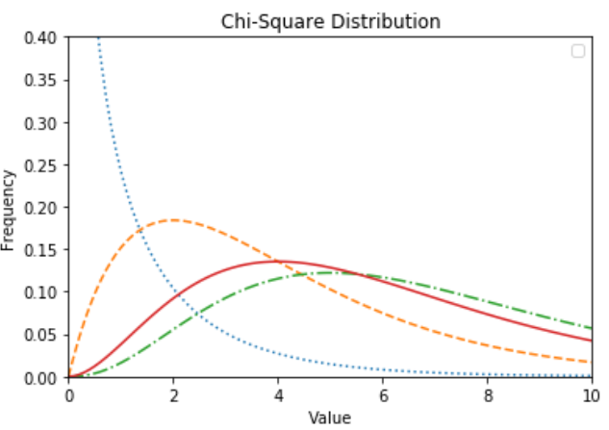
Chi – Square – Distribution - Output

Slide 65
Python – Linear Regression
In linear regression , two variables are related through an equation , where exponent of both these variables is 1.
A linear relationship denotes a straight line when plotted as a graph.
A non – linear relationship where the exponent of any variable is not equal to 1 creates a curve.

Slide 66
Python – Linear Regression
import seaborn as sb
from matplotlib import pyplot as plt
df = sb.load_dataset('tips')
sb.regplot(x = "total_bill", y = "tip", data = df)
plt.show()

Slide 67
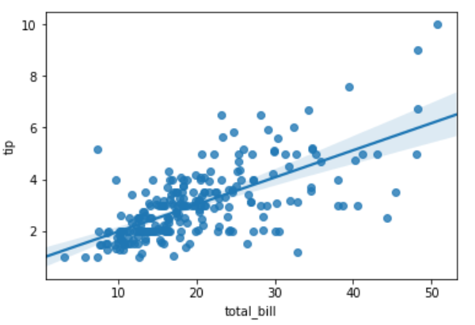
Linear Regression - Output

Slide 68
Python – Box Plots
They are measure of how well distributed the data in a dataset is.
It divides the dataset into three quartiles.
This graph represents the minimum, maximum, median, first quartile and third quartile in the dataset.
It is useful in comparing the distribution of data across datasets by drawing boxplots for each of them.

Slide 69
Python – Box Plots
Boxplots can be drawn calling Series.box.plot() and DataFrame.box.plot() .
DataFrame.boxplot() is used to visualize the distribution of values within each column.
The boxplot denotes five trials of 10 observations of a uniform random variable on [0,1).
import pandas as pd
import numpy as np
df = pd.DataFrame(np.random.rand(10, 5), columns=['A', 'B', 'C', 'D', 'E'])
df.plot.box(grid='True')

Slide 70
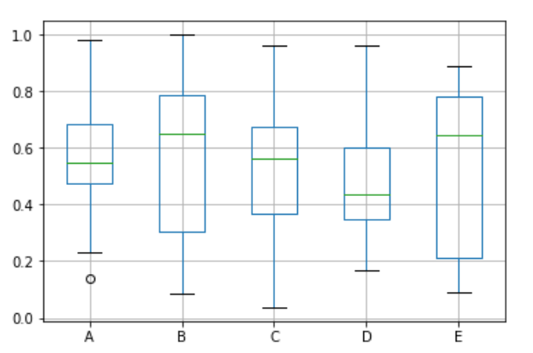
Box Plot - Output

Slide 71
Python – Heat Maps
A heatmap contains values representing various shades of the same colour for each value to be plotted.
The darker shades of the chart denote higher values than the lighter shade.
For a very different value , a completely different colour can also be used.
There is a two – dimensional plot of values which are mapped to the indices and columns of the chart.

Slide 72
Python – Heat Maps
from pandas import DataFrame
import matplotlib.pyplot as plt
data=[{2,3,4,1},{6,3,5,2},{6,3,5,4},{3,7,5,4},{2,8,1,5}]
Index= ['I1', 'I2','I3','I4','I5']
Cols = ['C1', 'C2', 'C3','C4']
df = DataFrame(data, index=Index, columns=Cols)
plt.pcolor(df)
plt.show()

Slide 73
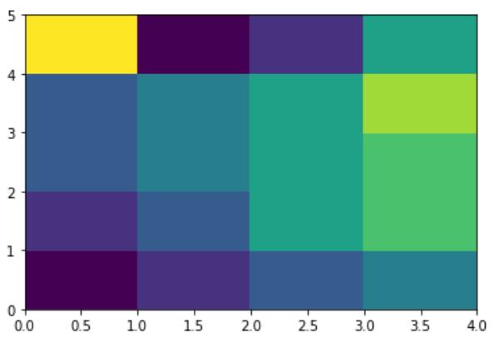
Python – Heat Maps - Output

Slide 74
Python – Scatter Plots
Scatter plots show many points plotted in the cartesian plane.
Each point represents the values of two variables.
One variable is chosen in the horizontal axis and one in the vertical axis.

Slide 75
Drawing a Scatter Plot
import pandas as pd
import numpy as np
df = pd.DataFrame(np.random.rand(50, 4), columns=['a', 'b', 'c', 'd']) df.plot.scatter(x='a', y='b')

Slide 76
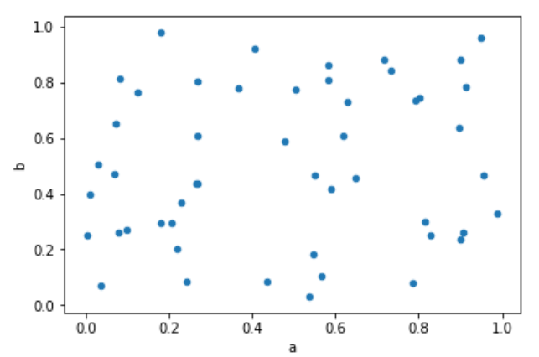
Scatter Plot - Output

Slide 77
Python – Bubble Charts
They display data as a cluster of circles.
Data required to create bubble charts needs to have xy coordinates , size of the bubble and colour of the bubbles.
The colours are given by the library.

Slide 78
Python – Drawing a Bubble Chart
import matplotlib.pyplot as plt
import numpy as np
# create data
x = np.random.rand(40)
y = np.random.rand(40)
z = np.random.rand(40)
colors = np.random.rand(40)
# use the scatter function
plt.scatter(x, y, s=z*1000,c=colors)
plt.show()

Slide 79
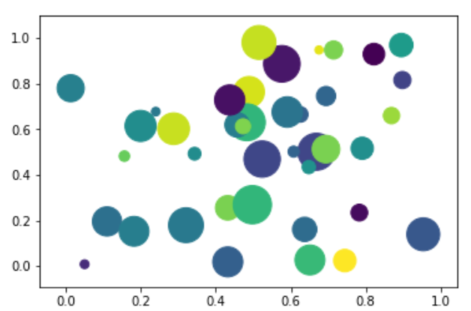
Bubble Chart - Output

Slide 80
Python – 3D Charts
It is also capable of creating 3D charts.
It involves adding a subplot to an existing 2D – plot and it assigns the projection parameter as 3D.

Slide 81
Python – Drawing a 3D Plot
from mpl_toolkits.mplot3d import axes3d
import matplotlib.pyplot as plt
chart = plt.figure()
chart3d = chart.add_subplot(111, projection='3d')
# Create some test data.
X, Y, Z = axes3d.get_test_data(0.08)
# Plot a wireframe.
chart3d.plot_wireframe(X, Y, Z, color='r',rstride=15, cstride=10)
plt.show()

Slide 82
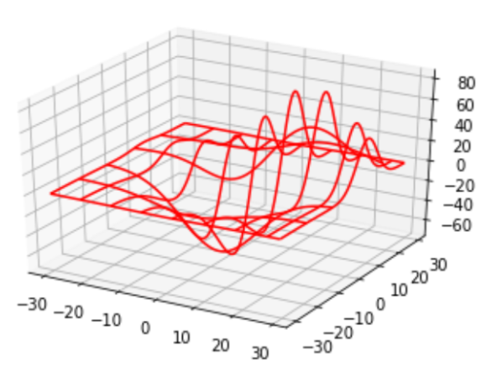
Drawing a 3D Plot - Output

Slide 83
Python – Graph Data
CSGraph stands for Compressed Sparse Graph.
It focuses on fast graph algorithms based on sparse matrix representations.
Graph Representations:
We should know what is sparse graph and how it helps in graph representations.

Slide 84
Sparse Graph
A graph is nothing but a collection of nodes , which have links between them.
Graphs can be used to represent anything like social network connections , where each node is a person and connected to acquaintances; images , where each node is a pixel and connected to neighbouring pixels.
The points lie in a high – dimensional distribution , where each node is connected to the nearest neighbours and practically anything else we can imagine.

Slide 85
Sparse Graph
One very efficient way to represent graph data is a sparse matrix.
It is called as G.
The matrix G is of size N*N.
G[i,j] gives the value of connection between node ‘i’ and node ‘j’.
A sparse graph contains mostly zeros – that is , most nodes have only a few connections.
IsoMap: A manifold learning algorithm , which requires finding the shortest paths in the graph.

Slide 86
Sparse Graph
Hierarchical Clustering: A clustering algorithm based on minimum spanning tree.
Spectral Decomposition: A projection algorithm based on sparse graph laplacians.

Slide 87
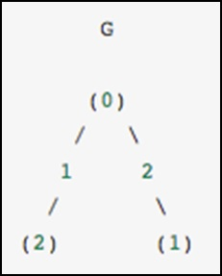
Sparse Graph

Slide 88
Sparse Graph - Examples
The graph contains three nodes , where node 0 and 1 are connected by an edge of weight 2 , nodes 0 and 2 are connected by an edge of weight 1.
A unidiretced graph is denoted by a symmetric matrix.

Slide 89
Sparse Graph - Examples
G_dense = np.array([ [0, 2, 1],
[2, 0, 0],
[1, 0, 0] ])
G_masked = np.ma.masked_values(G_dense, 0)
from scipy.sparse import csr_matrix
G_sparse = csr_matrix(G_dense)
print (G_sparse.data)

Slide 90
Sparse Graph - Output
array([2, 1, 2, 1])

